Slide 1
ANALYZING THE AGREEMENT OF THE THIN LENS EQUATION WITH CONVEX LENSES USING THE CHI-SQUARED TEST
Sheenah Ancheta | Kenneth Domingo
John Bert Lazaro | Ysabella Ong
Physics 192 Group 18

Slide 2
ABSTRACT
The thin lens equation neglects the thickness of a spherical lens.
In line with this, the experiment aims to statistically determine the level of agreement between experimental data and the theoretical model. A setup consisting of an incandescent bulb, transparent grid, diaphragm, lens, and a viewing screen was prepared.
Sets of values of image and object distances were obtained by varying the position of the lens. Results showed a close agreement between the theoretical and experimental focal lengths as well as between the magnification obtained by getting the ratio of the object and image distances and the magnification computed from the ratio of the object and image heights.

Slide 3
INTRODUCTION

Slide 4
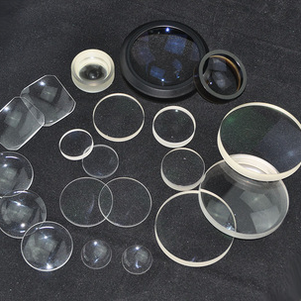
LENSES
refracting optical devices that focuses or disperses light
usually made with glass and normally has a spherical surface

Slide 5
Thin lenses
thickness of the lens appears to be negligible in comparison to the radius of curvature of the lens

Slide 6
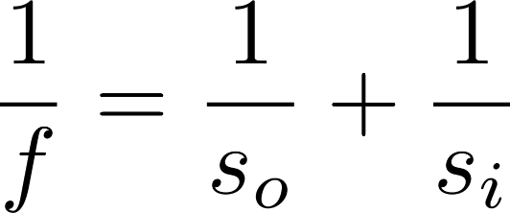

THIN LENS EQUATION
$f$ - the focal length of the lens used
$so$ - distance of the object from the lens
$si$ - distance of the image formed from the lens

Slide 7
CHI-SQUARED TEST
To determine whether there is a significant association between the two variables

Slide 8
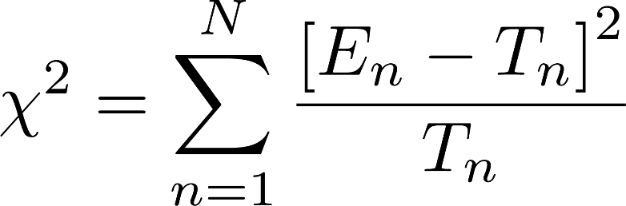
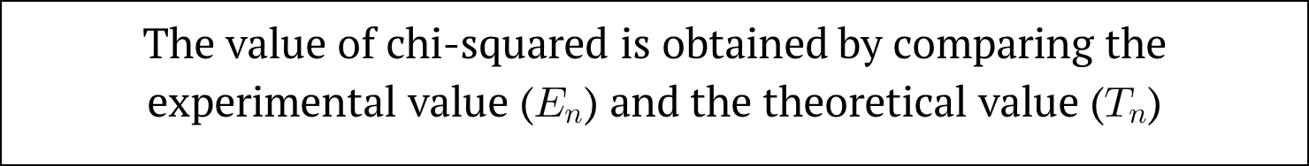
CHI-SQUARED TEST
The value of chi-squared is obtained by comparing the experimental value ($E_{n}$) and the theoretical value ($T_{n}$)

Slide 9

MAGNIFICATION
There are two ways to measure magnification consistent with the thin lens equation
$p$ = object distance
$q=$image distance
$d$ = object height
$d′$ = image height
Notes:
These two equations were compared by using the $χ^{2}$ test. Note that we just considered the magnitude of the magnification for the analysis.

Slide 10
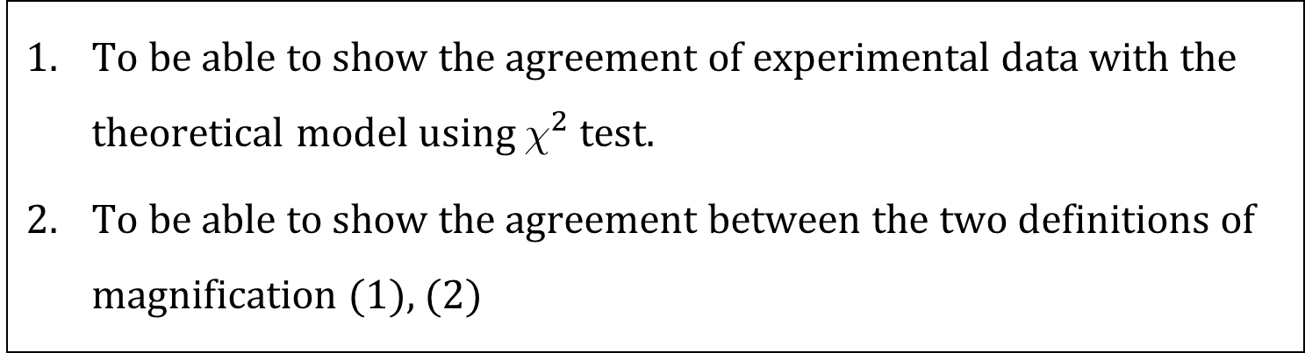
OBJECTIVES
To be able to show the agreement of experimental data with the theoretical model using $χ^{2}$ test.
To be able to show the agreement between the two definitions of magnification (1), (2)
Notes:
These two equations were compared by using the $χ^{2}$ test. Note that we just considered the magnitude of the magnification for the analysis.

Slide 11
METHODOLOGY

Slide 12
EXPERIMENTAL SETUP & PARAMETERS
GRID
VARIABLE APERTURE
VIEWING SCREEN
LENS
LIGHT SOURCE
OPTICAL BENCH
Object distance (p)
Image distance (q)
Figure 1. Thin Lens Setup consisting of an incandescent bulb as a light source projected onto a viewing screen with a variable aperture and a converging thin lens placed in between.
Light source: incandescent lamp
Lens: +200 mm
Grid spacing: 2.00 mm x 2.00 mm
No. of trials per p: 5
Object distance was varied 3x

Slide 13
RESULTS & DISCUSSION

Slide 14
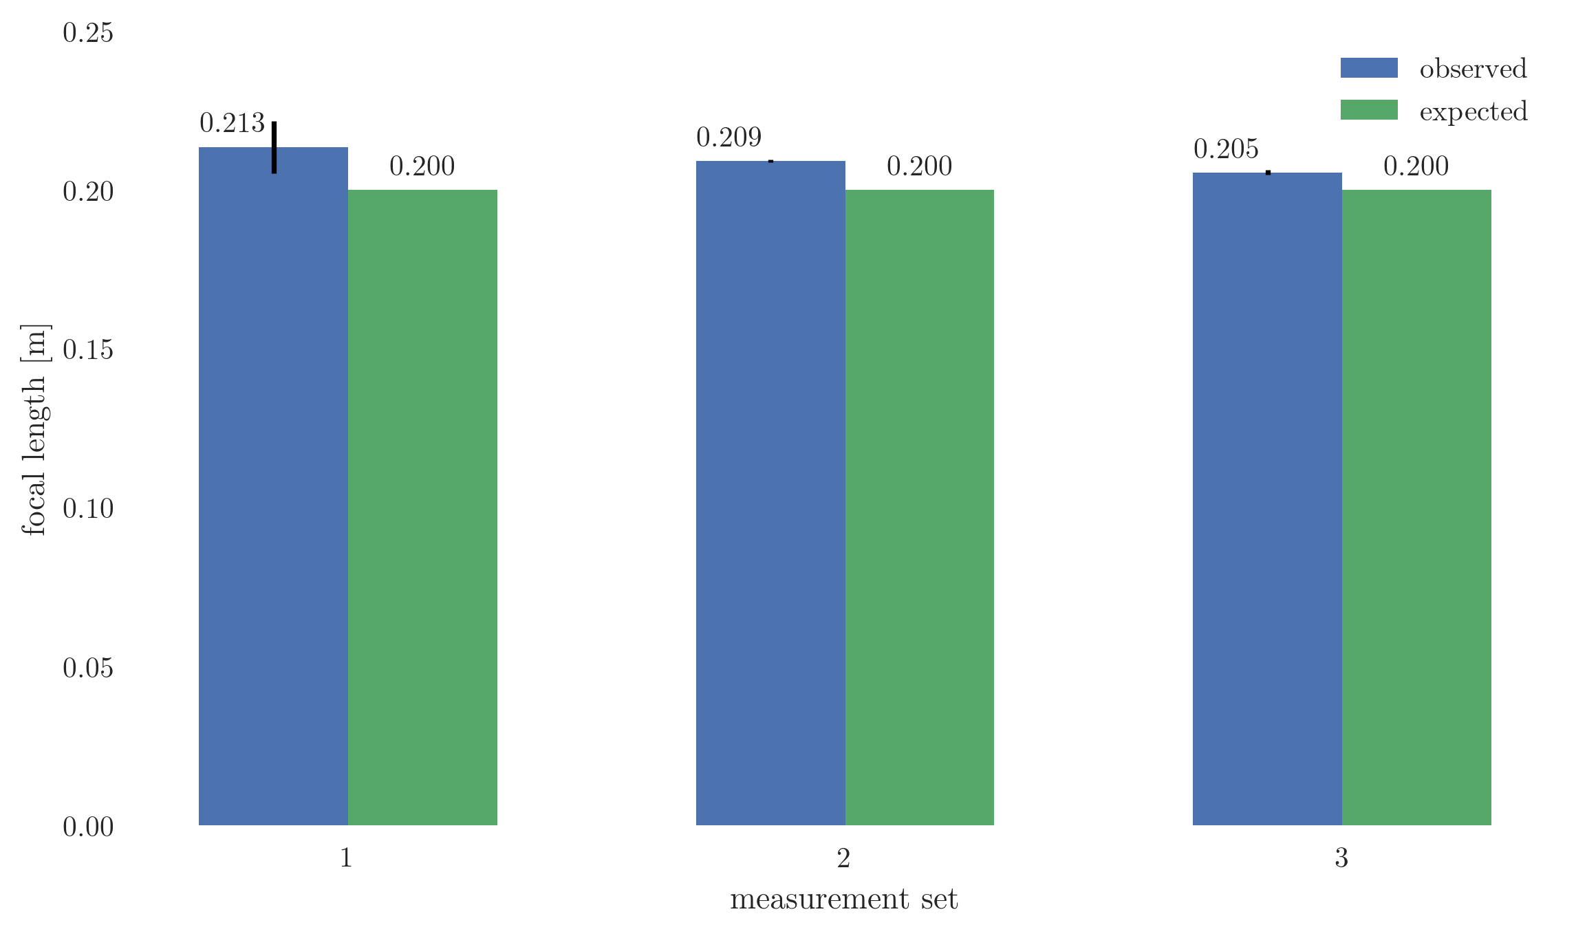




$χ^{2}$ TEST: FOCAL LENGTH
$$χ^{2}=1.73×{10}^{−3}$$
$$χ^{2}=4.7×{10}^{−6}$$
$$χ^{2}=1.7×{10}^{−5}$$

Slide 15
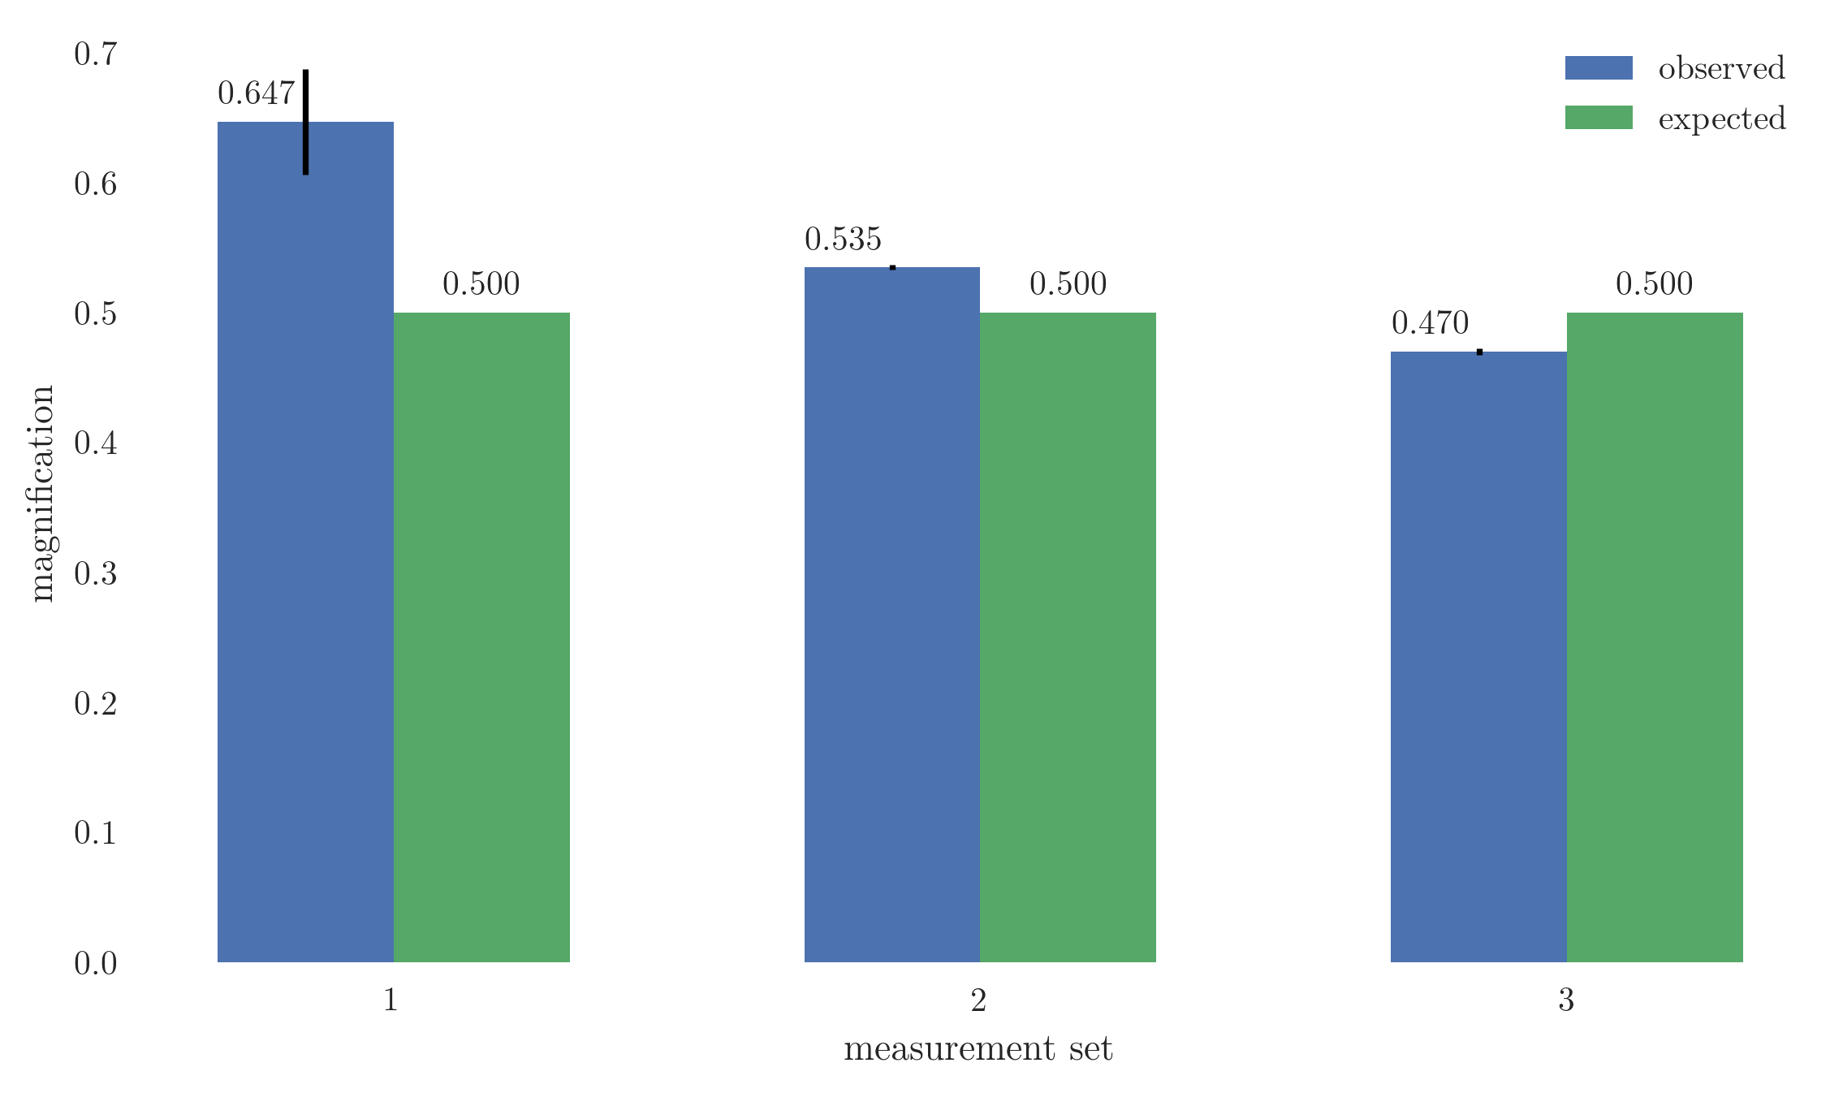
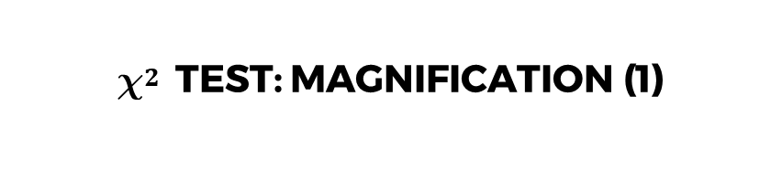


$χ^{2}$ TEST: MAGNIFICATION (1)
$$χ^{2}=0.015$$
$$χ^{2}=5.5×{10}^{−5}$$
$$χ^{2}=5.5×{10}^{−5}$$

Slide 16
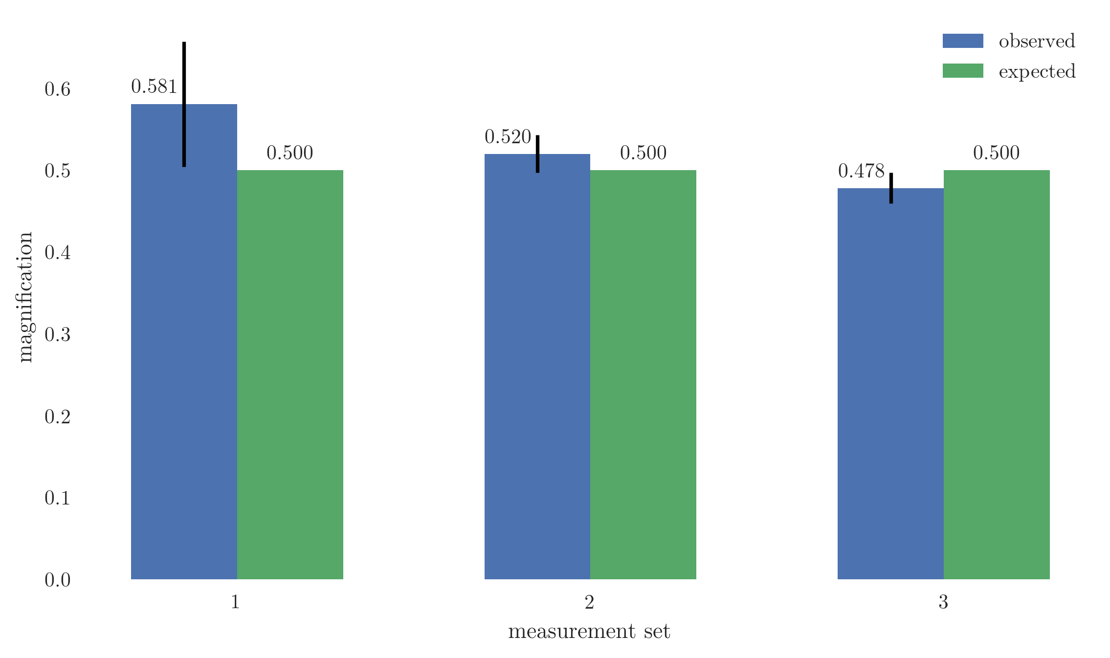
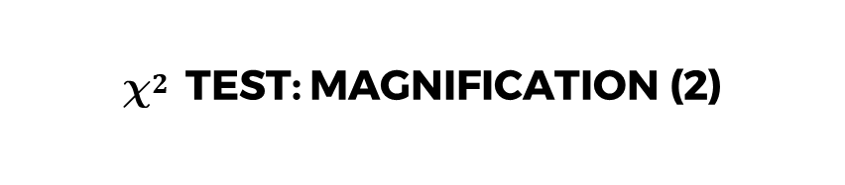



$χ^{2}$ TEST: MAGNIFICATION (2)
$$χ^{2}=0.060$$
$$χ^{2}=6×{10}^{−3}$$
$$χ^{2}=4.4×{10}^{−3}$$

Slide 17
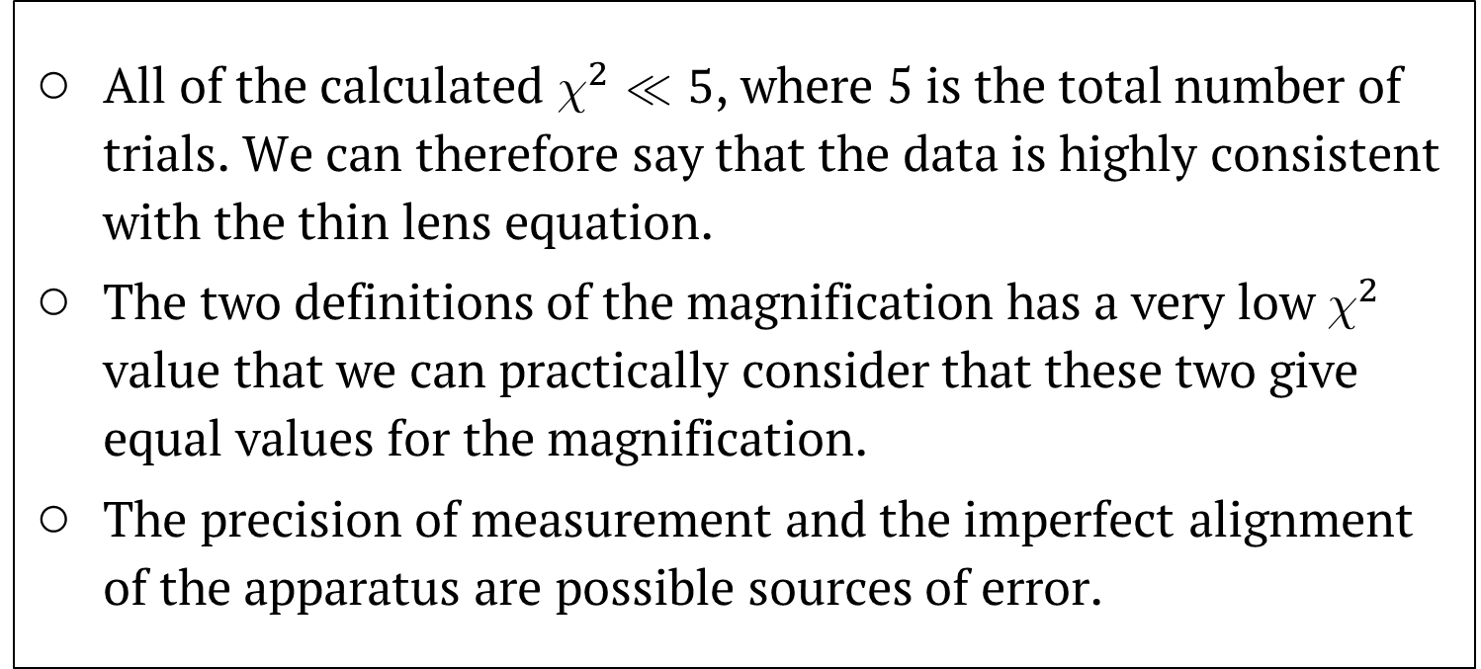

$χ^{2}$ TEST
All of the calculated $χ^{2}≪5$, where 5 is the total number of trials. We can therefore say that the data is highly consistent with the thin lens equation.
The two definitions of the magnification has a very low $χ^{2}$ value that we can practically consider that these two give equal values for the magnification.
The precision of measurement and the imperfect alignment of the apparatus are possible sources of error.

Slide 18
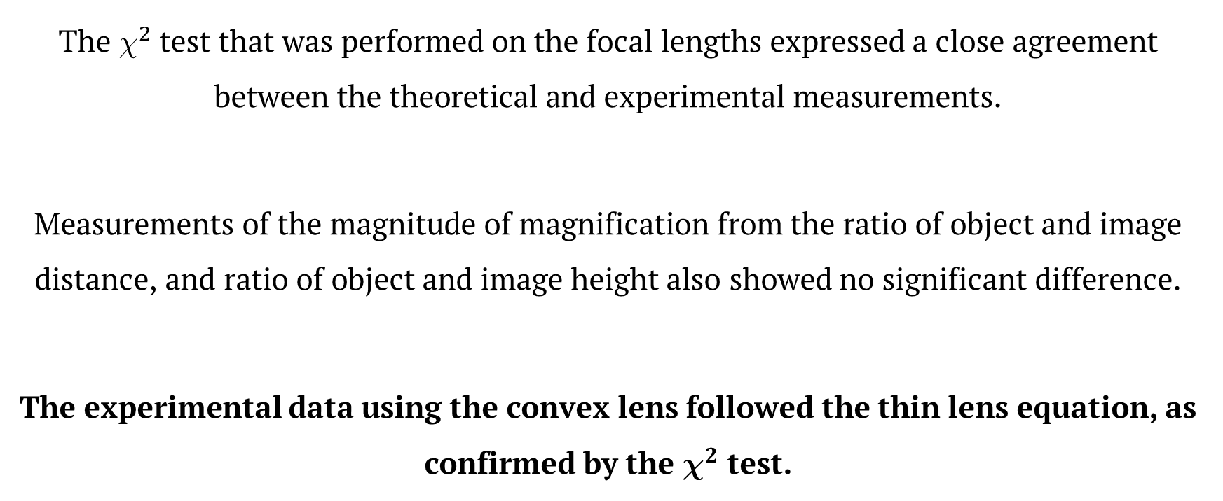
CONCLUSIONS
The $χ^{2}$ test that was performed on the focal lengths expressed a close agreement between the theoretical and experimental measurements.
Measurements of the magnitude of magnification from the ratio of object and image distance, and ratio of object and image height also showed no significant difference.
The experimental data using the convex lens followed the thin lens equation, as confirmed by the $χ^{2}$ test.

Slide 19
REFERENCES
J. Taylor, An Introduction to Error Analysis: The study of Uncertainties in Physical Measurements (University Science Books, Sausalito, California, 1997), 2nd ed.

